Slide 1
Genetic Algorithm

Slide 2
Introduction
Genetic Algorithm (GA) is a search-based optimization technique based on the principles of Genetics and Natural Selection. It is frequently used to find optimal or near-optimal solutions to difficult problems which otherwise would take a lifetime to solve. It is frequently used to solve optimization problems, in research, and in machine learning.

Slide 3
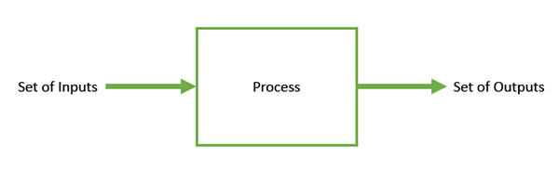
Optimization
Optimization is the process of making something better. In any process, we have a set of inputs and a set of outputs as shown in the following figure.

Slide 4
Optimization refers to finding the values of inputs in such a way that we get the “best” output values. The definition of “best” varies from problem to problem,
but in mathematical terms, it refers to maximizing or minimizing one or more objective functions, by varying the input parameters.
The set of all possible solutions or values which the inputs can take make up the search space. In this search space, lies a point or a set of points which gives the optimal solution. The aim of optimization is to find that point or set of points in the search space.

Slide 5
Advantages of GA
GAs have various advantages which have made them immensely popular. These include −
Does not require any derivative information (which may not be available for many real-world problems).
Is faster and more efficient as compared to the traditional methods.
Has very good parallel capabilities.
Optimizes both continuous and discrete functions and also multi-objective problems.
Provides a list of “good” solutions and not just a single solution.
Always gets an answer to the problem, which gets better over the time.
Useful when the search space is very large and there are a large number of parameters involved.

Slide 6
Limitations
Like any technique, GAs also suffer from a few limitations. These include −
GAs are not suited for all problems, especially problems which are simple and for which derivative information is available.
Fitness value is calculated repeatedly which might be computationally expensive for some problems.
Being stochastic, there are no guarantees on the optimality or the quality of the solution.
If not implemented properly, the GA may not converge to the optimal solution.

Slide 7

Installing the sklearn-genetic library

Slide 8
Working

Slide 9
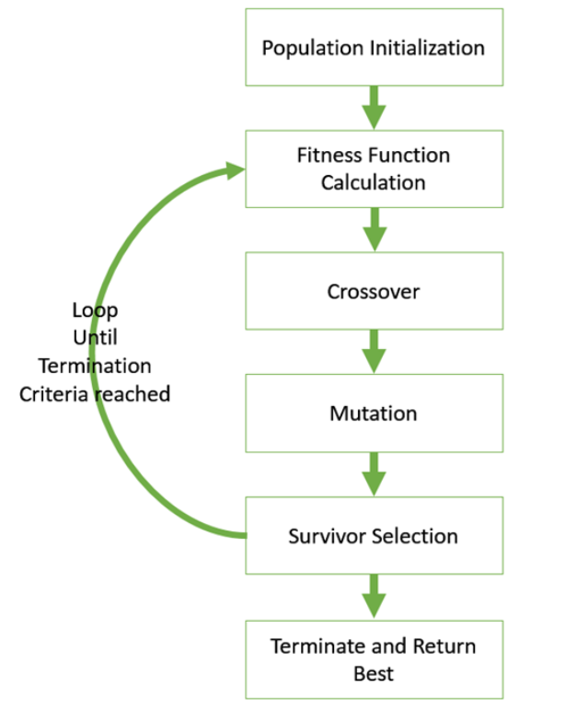

Slide 10
Terms to know
Here are quick steps for how the genetic algorithm works:
Initial Population– Initialize the population randomly based on the data.
Fitness function– Find the fitness value of the each of the chromosomes(a chromosome is a set of parameters which define a proposed solution to the problem that the genetic algorithm is trying to solve)
Selection– Select the best fitted chromosomes as parents to pass the genes for the next generation and create a new population
Cross-over– Create new set of chromosome by combining the parents and add them to new population set
Mutation– Perfrom mutation which alters one or more gene values in a chromosome in the new population set generated. Mutation helps in getting more diverse oppourtinity.Obtained population will be used in the next generation

Slide 11
Psuedocode
GA()
initialize population
find fitness of population
while (termination criteria is reached) do
parent selection
crossover with probability pc
mutation with probability pm
decode and fitness calculation
survivor selection
find best
return best

Slide 12
References
https://www.linkedin.com/pulse/genetic-algorithm-implementation-python-ahmed-gad/

Slide 13
Refrence

